Slide 1
Lecture 7: Spatio-temporal models
May 12, 2016

Slide 2
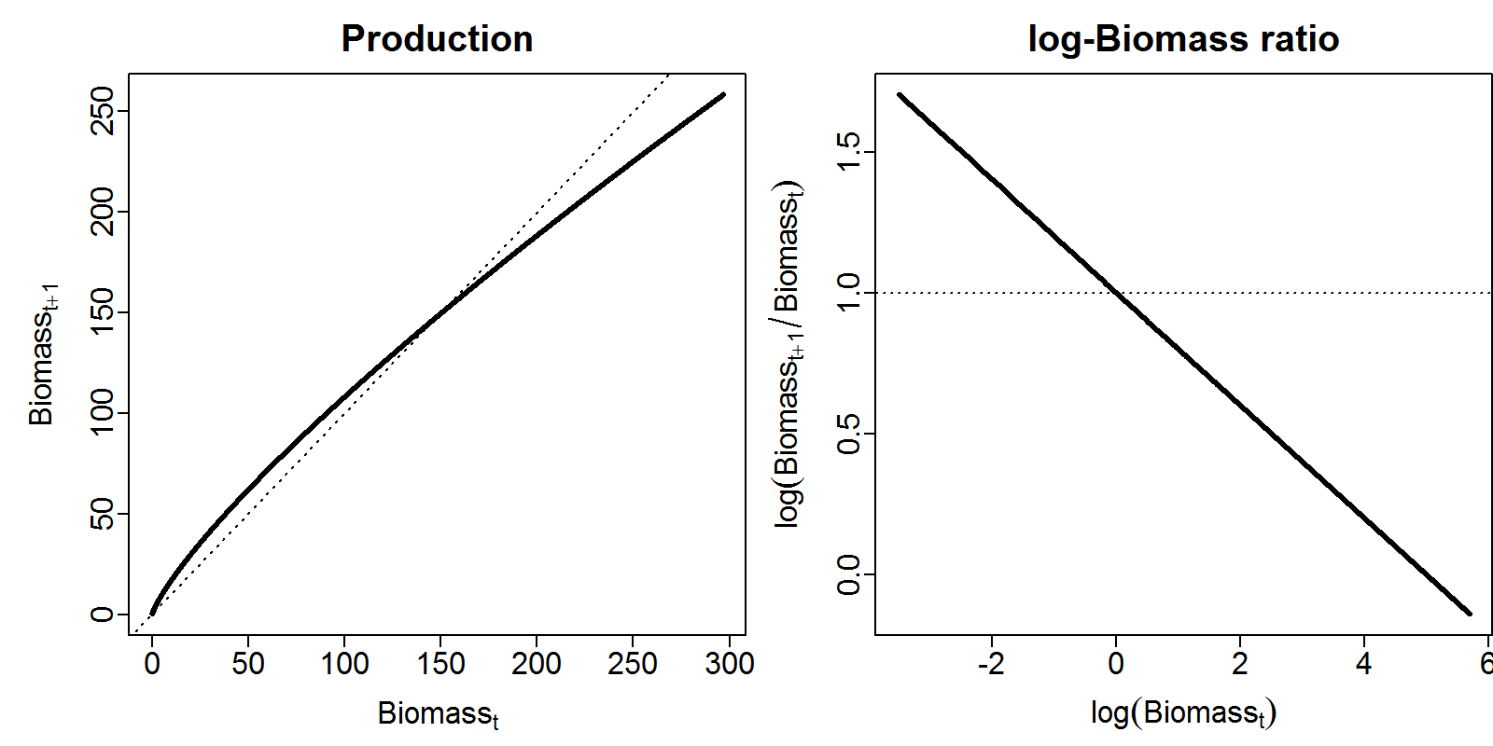

Gompertz model
$$d_{t+1}=d_{t}×exp⁡(α)×\exp\left(−β{log⁡(d}_{t})\right)×exp⁡(ε_{t})$$
$$ε_{t}\sim Normal(0,σ_{ε}^{2})$$
$$log⁡(b_{t})\sim Normal\left(log⁡(d_{t}),σ_{b}^{2}\right)$$

Slide 3
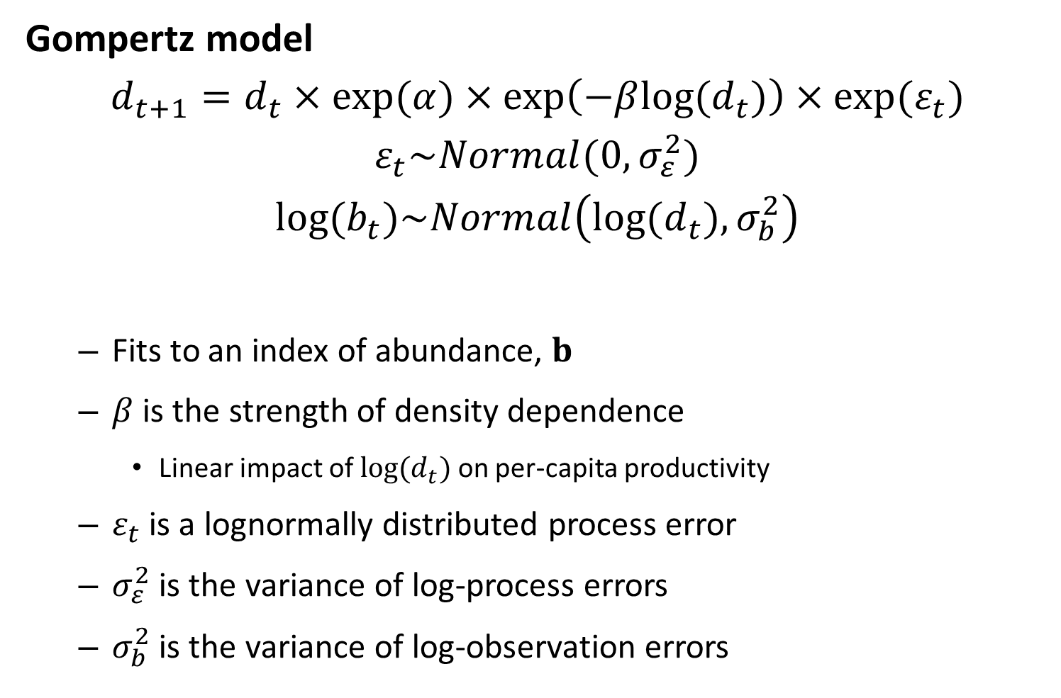
Gompertz model
$$d_{t+1}=d_{t}×exp⁡(α)×\exp\left(−β{log⁡(d}_{t})\right)×exp⁡(ε_{t})$$
$$ε_{t}\sim Normal(0,σ_{ε}^{2})$$
$$log⁡(b_{t})\sim Normal\left(log⁡(d_{t}),σ_{b}^{2}\right)$$
Fits to an index of abundance, $b$
$β$ is the strength of density dependence
Linear impact of ${log⁡(d}_{t})$ on per-capita productivity
$ε_{t}$ is a lognormally distributed process error
$σ_{ε}^{2}$ is the variance of log-process errors
$σ_{b}^{2}$ is the variance of log-observation errors

Slide 4
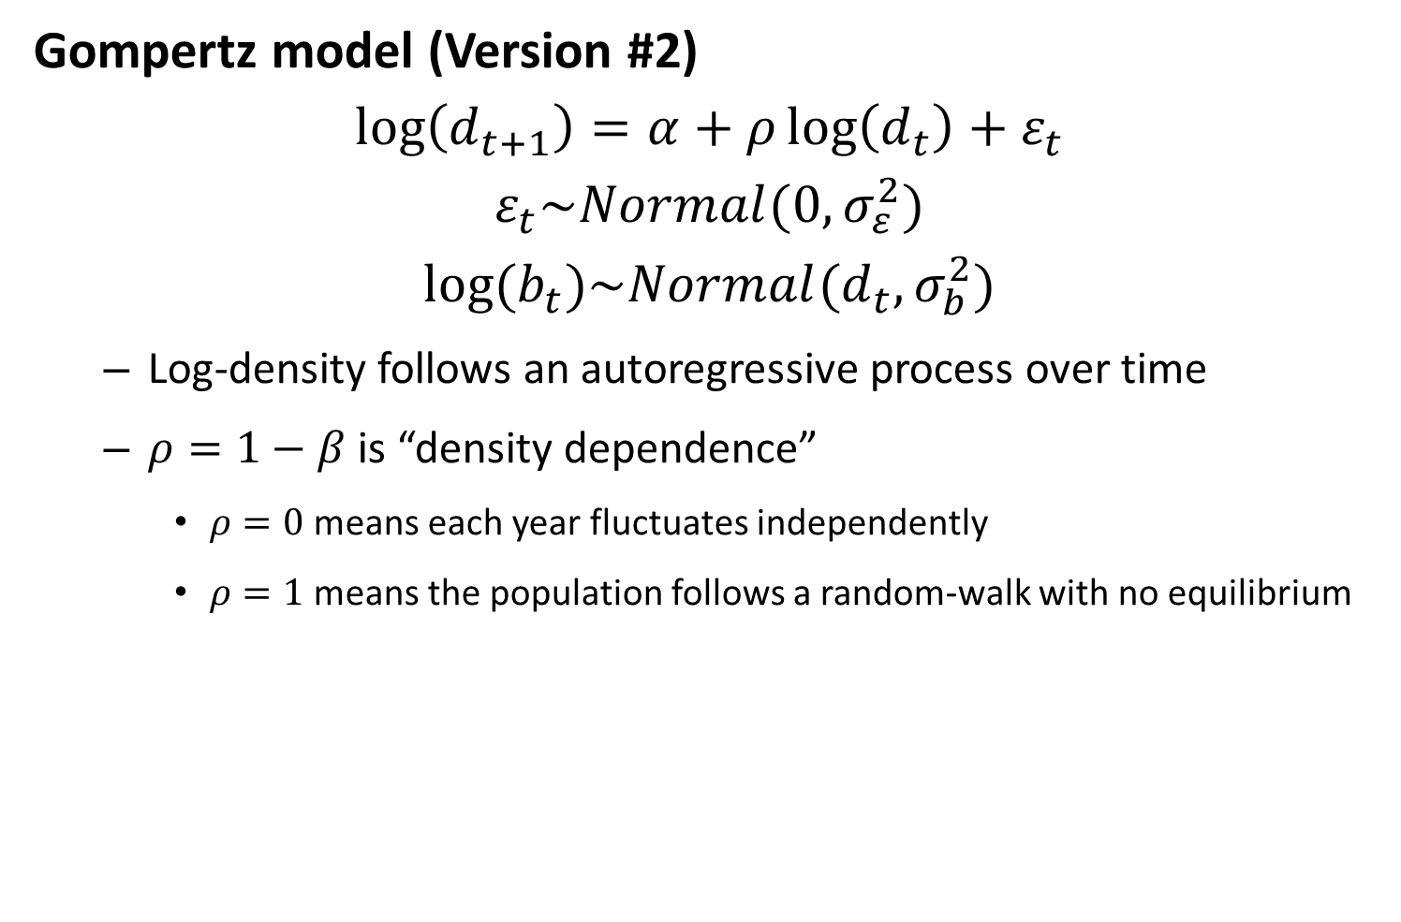
Gompertz model (Version #2)
$$\log\left(d_{t+1}\right)=α+ρ\log\left(d_{t}\right)+ε_{t}$$
$$ε_{t}\sim Normal(0,σ_{ε}^{2})$$
$$log⁡(b_{t})\sim Normal(d_{t},σ_{b}^{2})$$
Log-density follows an autoregressive process over time
$ρ=1−β$ is “density dependence”
$ρ=0$ means each year fluctuates independently
$ρ=1$ means the population follows a random-walk with no equilibrium

Slide 5

Gompertz model (version #3)
$$d=α+ε$$
$$ε\sim MVN(0,σ_{ε}^{2}R)$$
$$log⁡(b)\sim MVN(d,σ_{b}^{2}I)$$
Where $C$ is the correlation matrix for an AR1 process

Slide 6
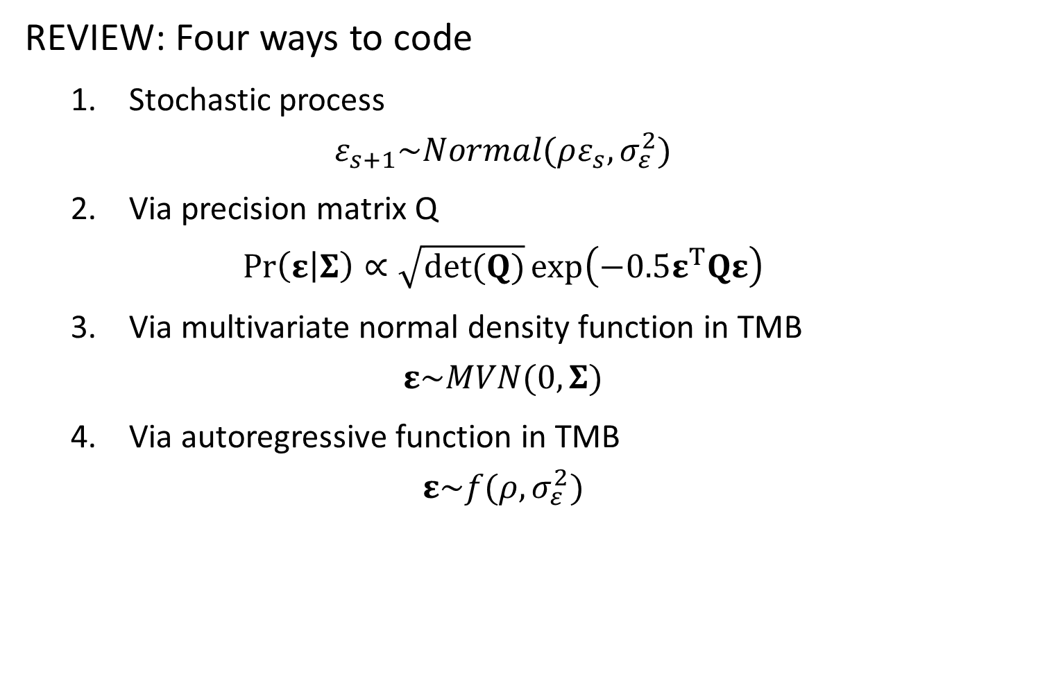
REVIEW: Four ways to code
1. Stochastic process
$$ε_{s+1}\sim Normal(ρε_{s},σ_{ε}^{2})$$
2. Via precision matrix Q
$$\operatorname{Pr}\left(ε | Σ\right)∝\sqrt{det(Q)}\exp\left(−0.5ε^{T}Qε\right)$$
3. Via multivariate normal density function in TMB
$$ε\sim MVN(0,Σ)$$
4. Via autoregressive function in TMB
$$ε\sim f(ρ,σ_{ε}^{2})$$

Slide 7
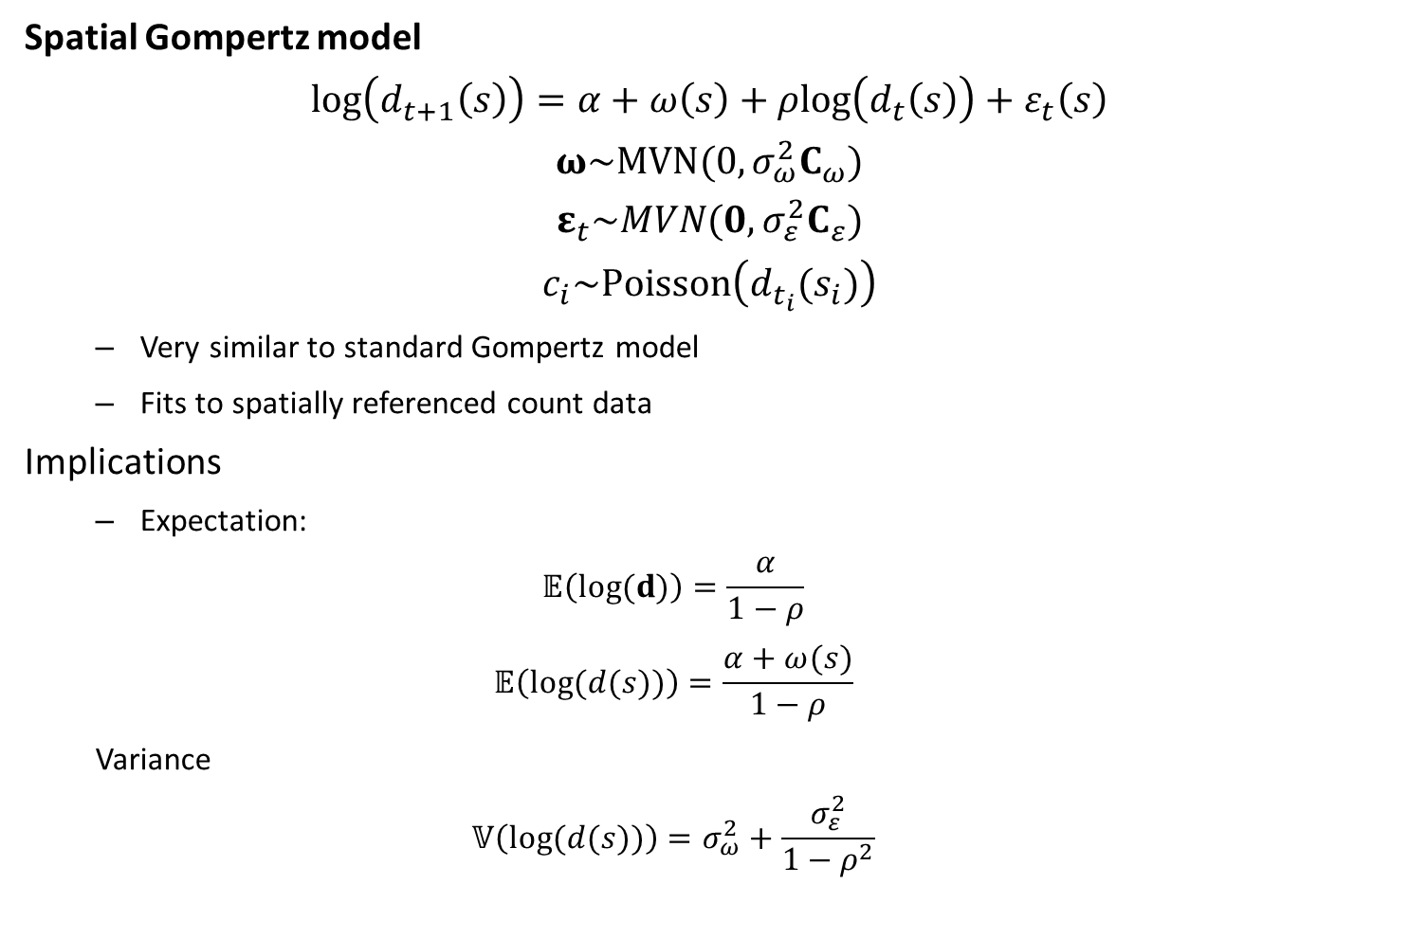
Spatial Gompertz model
$$log\left(d_{t+1}\left(s\right)\right)=α+ω\left(s\right)+ρlog⁡\left(d_{t}\left(s\right)\right)+ε_{t}\left(s\right)$$
$$ω\sim MVN(0,σ_{ω}^{2}C_{ω})$$
$$ε_{t}\sim MVN(0,σ_{ε}^{2}C_{ε})$$
$$c_{i}\sim Poisson\left(d_{t_{i}}(s_{i})\right)$$
Very similar to standard Gompertz model
Fits to spatially referenced count data
Implications
Expectation:
$$𝔼\left(log⁡(d)\right)=\frac{α}{1−ρ}$$
$$𝔼\left(log⁡(d(s))\right)=\frac{α+ω(s)}{1−ρ}$$
Variance
$$𝕍\left(log⁡(d(s))\right)=σ_{ω}^{2}+\frac{σ_{ε}^{2}}{1−ρ^{2}}$$

Slide 8


Spatial Gompertz model:
Can use same trick as “Gompertz model version #3”
$$c_{i}\sim Poisson(exp⁡(d_{t_{i}}(s_{i})))$$
$$d=α+ω+ε_{t}$$
$$ω\sim MVN(0,\frac{σ_{ω}^{2}}{1−ρ}C_{ω})$$
$$vec(Ε)\sim MVN(0,σ_{ε}^{2}C_{ε}⊗R)$$
Where $R$ is the correlation matrix for 1st order autocorrelation
R = $\left[\begin{matrix}1 & ρ & ρ^{2} & ... & ρ^{T−1} \\ ρ & 1 & ρ & ... & ρ^{T−2} \\ ρ^{2} & ρ & 1 & ... & ρ^{T−3} \\ ... & ... & ... & ... & ... \\ ρ^{T−1} & ρ^{T−2} & ρ^{T−3} & ... & 1\end{matrix}\right]$
Notes:
Match up conceptual parameters to parameters we’re estimating
Kroencker product – spatial variance * time variance
C is correlation matrix with unit variance
“decorrelation distance” → range parameter
C(omega) has different kappa value from C(epsilon) ---- for teaching purposes, using same kappa
Jointly model process error

Slide 9
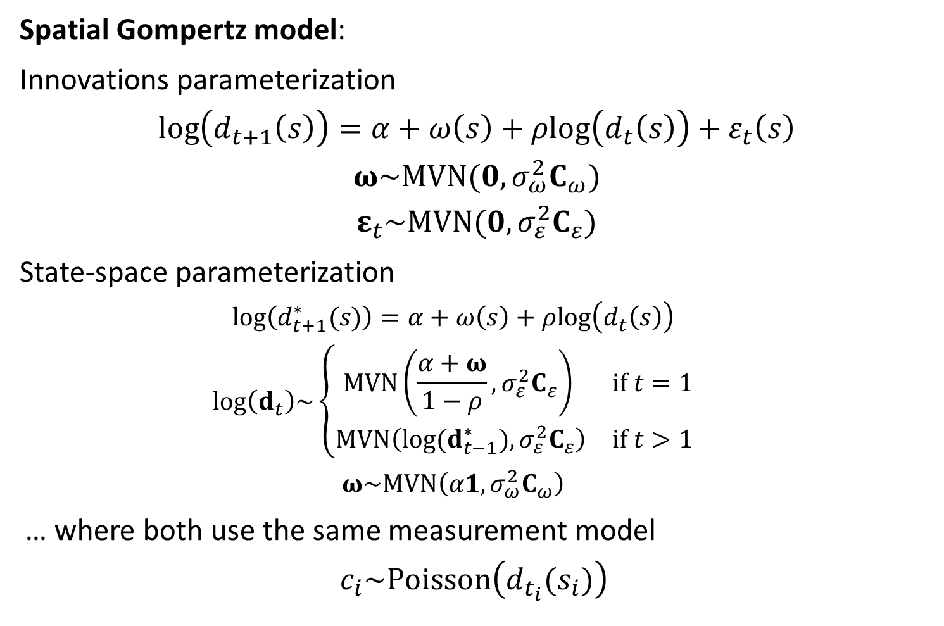
Spatial Gompertz model:
Innovations parameterization
$$\log\left(d_{t+1}\left(s\right)\right)=α+ω\left(s\right)+ρlog⁡\left(d_{t}\left(s\right)\right)+ε_{t}\left(s\right)$$
$$ω\sim MVN(0,σ_{ω}^{2}C_{ω})$$
$$ε_{t}\sim MVN(0,σ_{ε}^{2}C_{ε})$$
State-space parameterization
$$log⁡\left(d_{t+1}^{∗}(s)\right)=α+ω\left(s\right)+ρlog⁡\left(d_{t}\left(s\right)\right)$$
$$log⁡\left(d_{t}\right)\sim \left\{\begin{matrix}MVN\left(\frac{α+ω}{1−ρ},σ_{ε}^{2}C_{ε}\right) & if t=1 \\ MVN\left({log⁡(d}_{t−1}^{∗}),σ_{ε}^{2}C_{ε}\right) & if t>1\end{matrix}\right.$$
$$ω\sim MVN\left(α1,σ_{ω}^{2}C_{ω}\right)$$
… where both use the same measurement model
$$c_{i}\sim Poisson\left(d_{t_{i}}(s_{i})\right)$$
Notes:
Model epsilon vs. density as being random
Third parameterization would be joint process errors

Slide 10
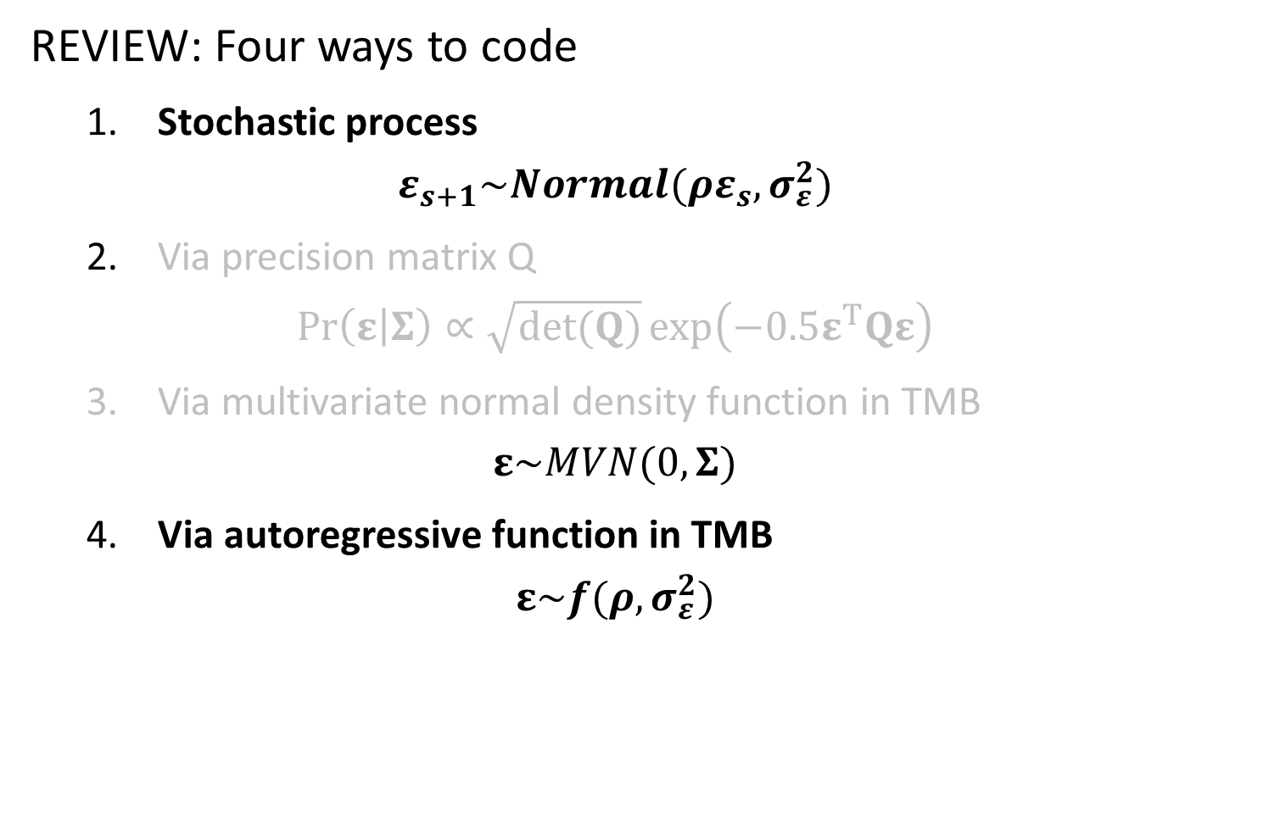
REVIEW: Four ways to code
1. Stochastic process
$$ε_{s+1}\sim Normal(ρε_{s},σ_{ε}^{2})$$
2. Via precision matrix Q
$$\operatorname{Pr}\left(ε | Σ\right)∝\sqrt{det(Q)}\exp\left(−0.5ε^{T}Qε\right)$$
3. Via multivariate normal density function in TMB
$$ε\sim MVN(0,Σ)$$
4. Via autoregressive function in TMB
$$ε\sim f(ρ,σ_{ε}^{2})$$

Slide 11
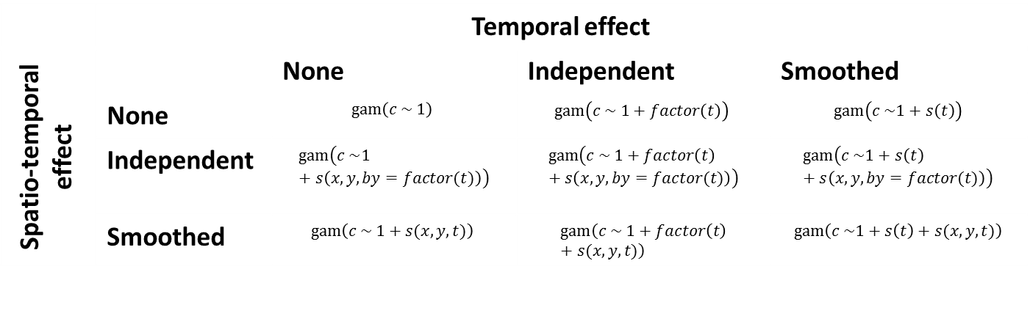
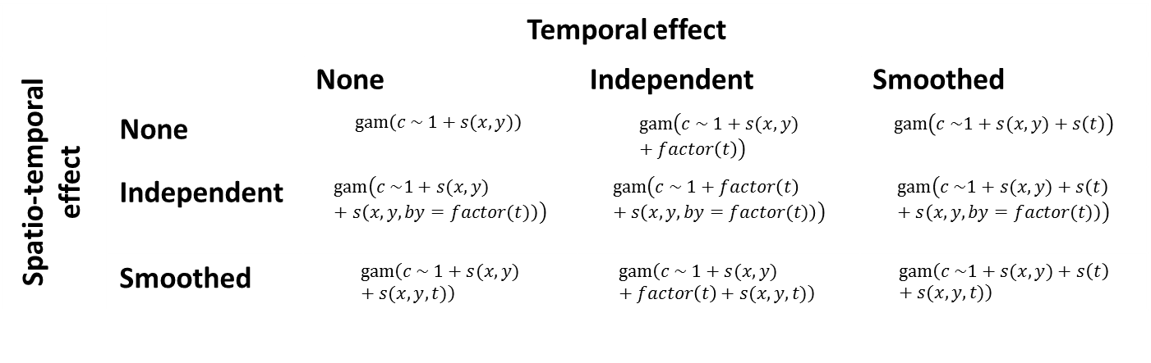
Without spatial
With spatial
 | Temporal effect
Spatio-temporal effect |  | None | Independent | Smoothed
 | None | $$gam\left(c \sim 1\right)$$ | $$gam\left(c \sim 1+factor\left(t\right)\right)$$ | $$gam\left(c \sim 1+s\left(t\right)\right)$$
 | Independent | $$gam\left(c \sim 1+s\left(x, y,by=factor(t)\right)\right)$$ | $$gam\left(c \sim 1+factor\left(t\right)+s\left(x, y,by=factor(t)\right)\right)$$ | $$gam\left(c \sim 1+s\left(t\right)+s\left(x, y,by=factor(t)\right)\right)$$
 | Smoothed | $$gam\left(c \sim 1+s(x,y,t)\right)$$ | $$gam\left(c \sim 1+factor\left(t\right)+s(x,y,t)\right)$$ | $$gam\left(c \sim 1+s\left(t\right)+s(x,y,t)\right)$$
 | Temporal effect
Spatio-temporal effect |  | None | Independent | Smoothed
 | None | $$gam\left(c \sim 1+s(x,y)\right)$$ | $$gam\left(c \sim 1+s(x,y)+factor\left(t\right)\right)$$ | $$gam\left(c \sim 1+s(x,y)+s\left(t\right)\right)$$
 | Independent | $$gam\left(c \sim 1+s(x,y)+s\left(x, y,by=factor(t)\right)\right)$$ | $$gam\left(c \sim 1+factor\left(t\right)+s\left(x, y,by=factor(t)\right)\right)$$ | $$gam\left(c \sim 1+s(x,y)+s\left(t\right)+s\left(x, y,by=factor(t)\right)\right)$$
 | Smoothed | $$gam\left(c \sim 1+s(x,y)+s(x,y,t)\right)$$ | $$gam\left(c \sim 1+s(x,y)+factor\left(t\right)+s(x,y,t)\right)$$ | $$gam\left(c \sim 1+s(x,y)+s\left(t\right)+s(x,y,t)\right)$$
Notes:
No temporal effect
Yes spatial effect
Yes spatio-temporal effect (smoothed)

Slide 12
What to do if you have 1000s of unique locations?
Get a bigger computer
TMB allows parallelization
Decrease spatial resolution
Define number of “knots”
Run k-means algorithm to identify placement of knots
Minimize distance between locations and nearest knot
Associate each sample with the nearest knot
Assumes that density is constant at finer scales than the distance between knots
Run in batches
Run model on smaller scales
Run “meta-analysis” model on results from each small-scale model

Slide 13
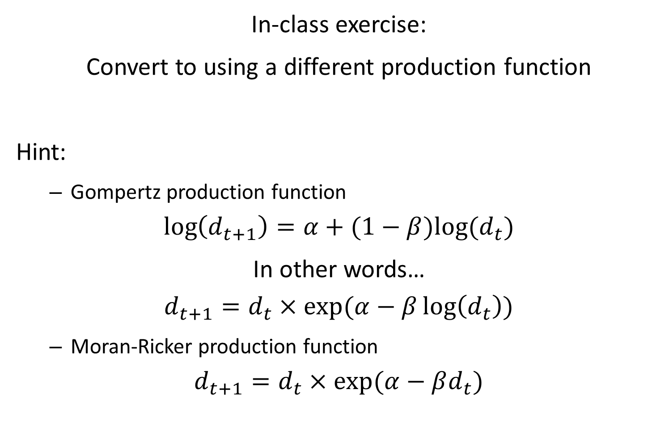
In-class exercise:
Convert to using a different production function
Hint:
Gompertz production function
$$\log\left(d_{t+1}\right)=α+(1−β)log⁡(d_{t})$$
In other words…
$$d_{t+1}=d_{t}×exp⁡(α−β\log\left(d_{t}\right))$$
Moran-Ricker production function
$$d_{t+1}=d_{t}×exp⁡(α−βd_{t})$$

